Slide 1
DynamoLLM: Designing LLM Inference Clusters for Performance and Energy Efficiency
Agithe Yeshwanth - MT25059

Slide 2
Datacenter energy management for Generative Large Language Model (LLM) serving.
Prefill vs. Decode Phases: LLM phases—processing input (compute-heavy) vs. generating output (memory-heavy).
TTFT & TBT: Metrics for speed—Time to First Token and Time Between Tokens.
Tensor Parallelism (TP): Splitting one model across multiple GPUs (e.g., TP4, TP8).
SLO (Service Level Objective): Service Level Objective (strict latency deadlines).

Slide 3
Problem
The Problem: Static configurations of the LLM clusters are used in order to cater to peak loads.
Reality Check: Traffic on LLMs is extremely dynamic and heterogeneous in nature.
Outcome: Significant waste of energy.

Slide 4
Motivation
Scale: Millions of queries are processed by LLMs each day.
Consequences: GPUs account for the majority of the datacenter’s electricity consumption, and operating these GPUs inefficiently results in significant greenhouse gases.
Objectives: To reduce costs and carbon footprint without compromising user deadlines.

Slide 5
State of the Art (SOTA) & Related Work
Existing Approaches for LLM: They consider only efficiency and latency (neglecting power).
Power Optimization Frameworks: Existing GPU approaches optimize just frequency (missing relevant knobs).
Baseline Approach ("Single Pool"): Allocating sufficient high-performance servers for handling peak demands.

Slide 6
The Research Gap
Lack of Focus: There is no current approach that specifically focuses on optimizing energy usage while running LLM services.
Problem of Complex Search Space: It is too complicated to optimize tuning, parallelism, and frequency at once.
High Reconfiguration Cost: Conventional approaches like autoscaling require minutes and affect ongoing connections.

Slide 7
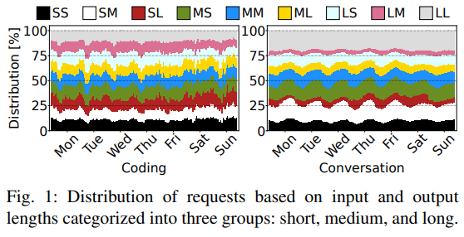
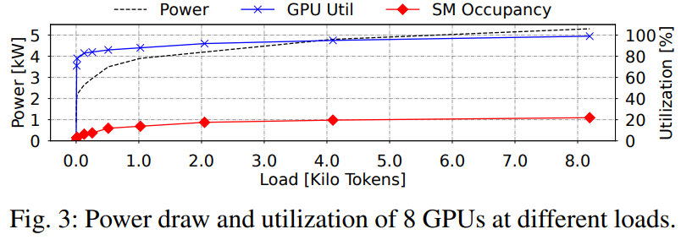
Key Workload Insights

Slide 8
Key Workload Insights
Heterogeneity: Short requests require few GPUs and low frequencies, while long requests require full utilization.
Dynamicity: Daily fluctuations lead to significant "idle time" for energy conservation.
Energy Proportionality: An idle GPU still consumes lots of energy (e.g., up to 550 W).

Slide 9
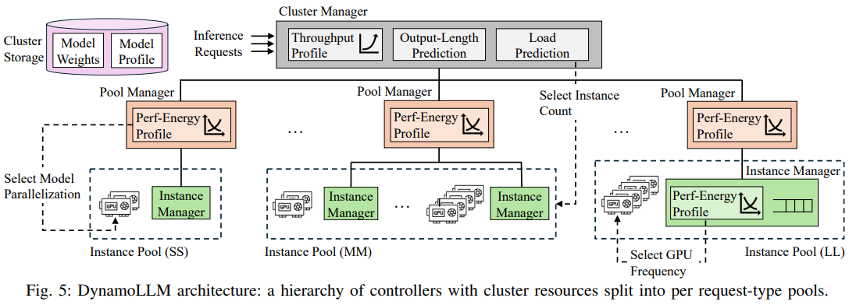
DynamoLLM Architecture

Slide 10
DynamoLLM Architecture
Summary: The initial framework for automated energy management of LLM clusters.
Classification: Categorizes requests into separate pools depending on expected I/O size.
Hierarchical Cluster: Increases/Decreases server nodes.
  Pools: Changes the TP ratio (TP2, TP4, TP8)
  Instances: Changes the frequency of GPU usage depending on load.

Slide 11
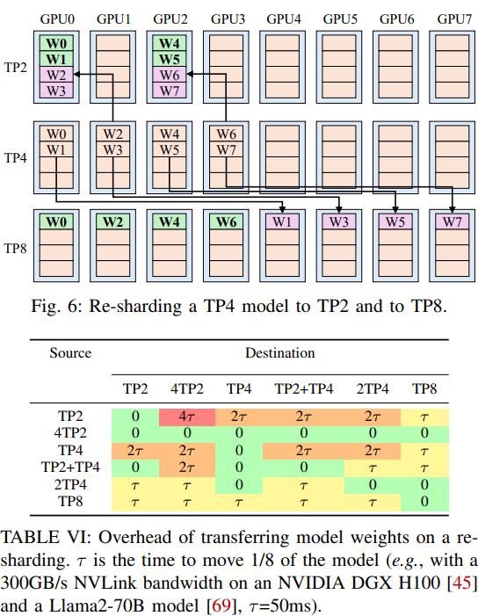
Hiding the Reconfiguration Overheads

Slide 12
Hiding the Reconfiguration Overheads
VM Scaling: Pre-warms VMs in the background before traffic spikes hit.
Smart Re-sharding: Uses an algorithm to keep model weights stationary, moving the rest directly via high-speed NVLink.
Frequency Tuning: Keeps the NVIDIA interface in memory to change clock speeds in milliseconds.

Slide 13
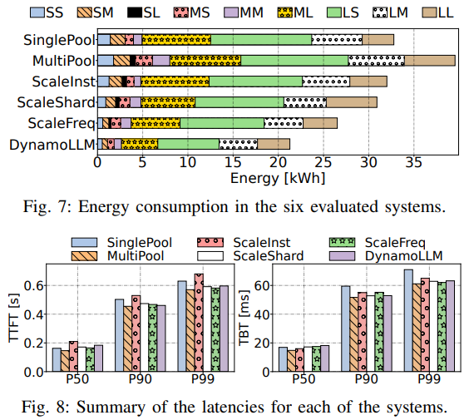
Evaluation & Results

Slide 14
Evaluation & Results
Energy & Carbon Footprint: Conserve 52% energy usage and reduce carbon emissions from operations by 38%.
Operational Cost: Reduce customer expenses by 61% (fewer overall GPU usage).
Performance: Satisfies all service-level objectives (SLOs) while minimizing tail latency (P99).

Slide 15
Conclusion
We don't have to choose between LLM performance and sustainability.
By treating hardware and software configurations as dynamic knobs, clusters can perfectly match resources to the immediate workload.
DynamoLLM paves the way for greener, highly scalable AI infrastructure.

